Slide 1
Proposed Agenda For CTS Leadership Meeting (ING4103)
07:00 Setup, Coffee, Sign-in, Networking, Breakfast
07:55 Call to Order, Approve Agenda
08:00 Roll Call / Introductions
08:20 Section and Officers
09:00 Committee reporting, FIN Committee, Nomination & Election, Next year Fall meeting:
10:00 Coffee Break (Joing with Student Brances)
10:30 Membership Development, Member Upgrade, Website, Enhanced Newsletter, Comm. Portal
STEM, YP, PACE, (AP03/MTT17, IM, LM
11:15 Chapter/ affinity Group Reports*
CTCN, PI2, PES, SMC/AES, CAS/SSC,
TEM & TEM-Grad, E25, WIE, Elec Devices (ED15)
12:00 Lunch
13:00 Student Branch Chair Activities
14:15 Chapter Reports continued
EMBS-SA, Computer-SA, Computer/EMBS-SA, (ComSoc/SP & EMBS/Computer)-AUS,
SEN, EMC27, CEDA, PHO36, CPMT21, Magnetics/Nano Tech
14:45 New Business/Motion
15:00 Adjourn

Slide 2
Proposed Agenda For CTS Leadership Meeting (ING4103)
07:00 Setup, Coffee, Sign-in, Networking, Breakfast
07:55 Call to Order, Approve Agenda
08:00 Roll Call / Introductions
08:20 Section and Officers
Chairman’s Report, Vice Chairs Report (Austin and San Antonio)
Finance/Budget Plan
09:00 Committee reporting, Initiatives update, PARP, Next year Fall meeting:
- FIN Committee
- Nomination Committee, Election
- Review Relevant PARP (Drafts for approval consideration)
- When 2020 Fall meeting will be held?:
10:00 Coffee Break (Joing with Student Brances)
10:30 Membership Development, Member Upgrade
Website & Social Media,
Enhanced Newsletter, Communications Portal
STEM, YP, PACE, (AP03/MTT17, IM)
LM ( Austin, San Antonio), Tech Tour

Slide 3
Proposed Agenda For CTS Leadership Meeting (ING4103) Cont’d
11:15 Chapter/ affinity Group Reports*
CTCN, PI2, PES, SMC/AES, CAS/SSC,
TEM & TEM-Grad, E25, WIE, Elec Devices (ED15)
12:00 Lunch
13:00 Student Branch Chair Activities
Introduction by Larry Larson
Connection with R5 (Christopher Sanderson)
Student Conference
14:15 Chapter Reports continued
EMBS-SA, Computer-SA, Computer/EMBS-SA, (ComSoc/SP & EMBS/Computer)-AUS,
SEN, EMC27, CEDA, PHO36, CPMT21, Magnetics/Nano Tech
14:45 New Business/Motion
- Recap: Summary of HELP needed by Heena and Nils
- Future Events
15:00 Adjourn

Slide 4
IEEE Central Texas Section
2019 Fall Leadership Planning Meeting
August 24, 2018
San Marcos, TX
Section Committee/Officer Name: Fawzi Behmann
Chapter/Affinity Name: Chair, Central Texas Section
Prepared by: Fawzi Behmann

Slide 5
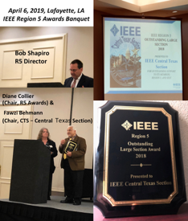
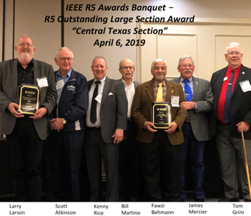
IEEE Central Texas Section (CTS)
2018 Region5 Large Section Outstanding Award*
(*) Application provides a good summary of CTS achievements

Slide 6
Vision/Mission
CTS Mission
To be RELEVANT to the members and community at large.
Bring relevant & intriguing technical topics, delivered by domain experts increasing audience satisfaction
Improve Communications and Training
Building communities of Interest: K-12, Student Engagement, Young Professional
Outreach Initiatives: Collaborate with consortiums/councils, special interest groups, industry, government and academia
Collaboration with other sections, regions, and societies

Slide 7
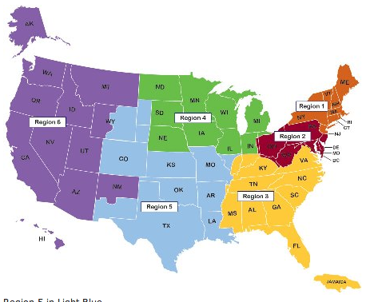
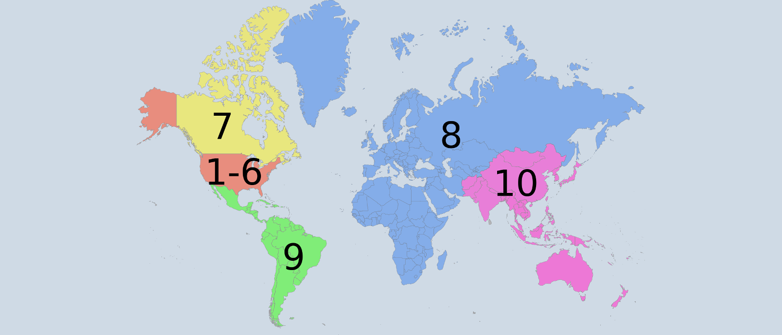
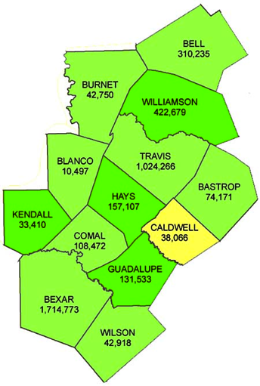

IEEE Central Texas Section (CTS)
REGION 5
CTS Counties
CTS Mission
Be RELEVANT to the members and community at large
  Members 3,939 members (Distribution List ~10,000)
  over 48 Fellows
  over 428 Senior Members
  32 Chapters, Affinity Groups, Student Chapters
  Over 300 meetings in 2018
  2 ExCom & SecCom face-to-face meetings/year.
  Monthly ExCom conference meetings
Also, now have publicity 4x6 card

Slide 8
2019 Initiatives & Key Accomplishments
CTS Icon and Boundaries
Sources:
Art library – authorized images
IEEE MGS Ops Manual
Google search and Wikipedia
Deliverables:
Designed logo for CTS that is ported to various use cases: Presentations, Banners, as sponsorship icon, letter head, etc.
Defined CTS boundaries by counties for analysis and use for membership drive and expanding territory

Slide 9
2019 Initiatives & Key Accomplishments
More targeted efforts to fill out vacant positions, create new ones and rebuilt chapters after being doormat (some for years)
Deliverables:
Vice-chair Austin
Vice Chair San Antonio
EMBS Chair San Antonio
APP/MTT Chair
IM Chair
CEDA – WIP

Slide 10
2019 Initiatives & Key Accomplishments
Initial AI For CTS Leadership
Sources:
OU Analytics
vTools reporting
IEEE MGA contract information
Deliverables:
Reconcile and build co-related records for CTS leadership
Updating Officers positions and created a process
Created a core list to be ported on CTS website as well as for chairs as frequently used tools
Work towards having website link with vtools officer reporting for update

Slide 11
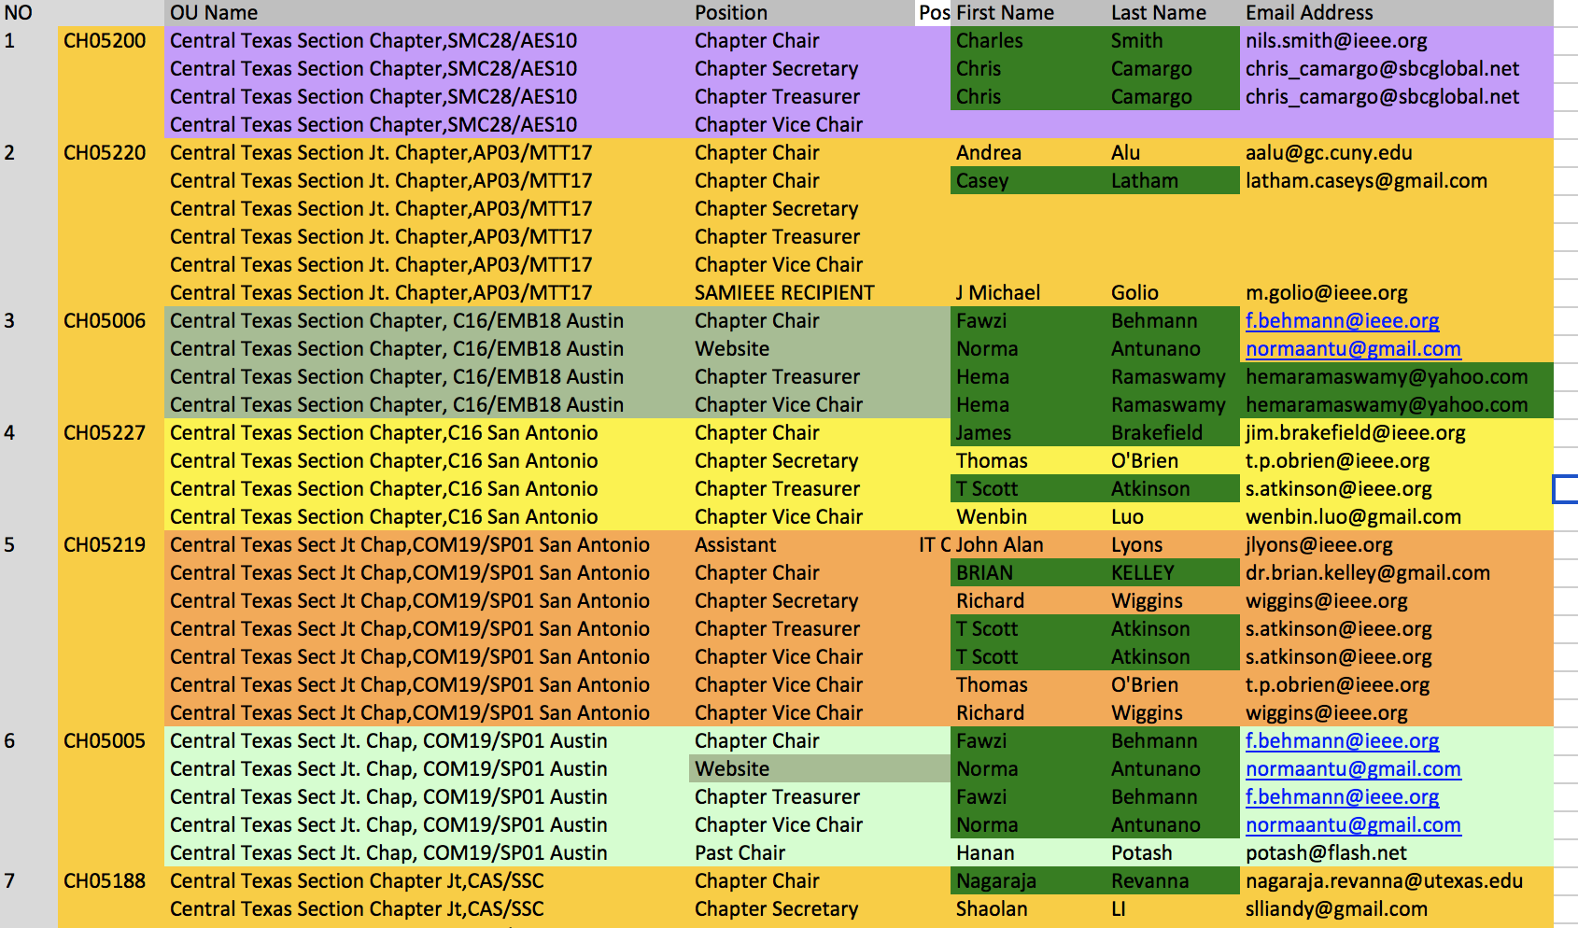
2019 Initiatives & Key Accomplishments

Slide 12
CTS Leadership
CTS Officers
Chapters/Affinity
Standing Committees/Coordinators
Chair
Fawzi Behmann
Vice Chair – A
Heena Rathore
Vice Chair – SA
Nils Smith
Secretary
Treasurer
Bill Martino
Past Chair
Leslie Martinich
Student Branch
Student Branch Chapters
Strategic Plan
Policies and Procedures PARP
Awards and Recognition
Nomination Committee
Election Committee
FIN/Audit Committee
Membership Development
Electronics Communications
Website
Communications Portal
Conferences/Events
Section-Chapter Vitality Chair
K-12/STEM Educational Activities
Students Activities
Professional Activities – PACE
Outreach Program
Conferences/Events

Slide 13
CTS Leadership
Steps to Update the Officer Information
Link to IEEE vtools officer reporting. https://officers.vtools.ieee.org/
Click “manage officers” icon to get sign in pop-up.
Enter the your email address and password.
Select the respective organizational unit to manage: for instance add the chapter code CH05009. Or start typing the name of your unit – a pull down menu will populate with choices.
Select the radio button for the officer position from the list. Click “ Add officer” or “End Term” button.
Change or add officer information (chair, secretary, treasurer, vice chair etc) by inputting the membership number and the start term date for the new officer.
If the position you are reporting is not in the list, please request it by clicking on "Request a new officer position" and sending a note to the IEEE staff.
In order to make changes to an existing position, click on a radio button to the left of the position title.
Once, a position is selected, you can add a new officer to the selected position by clicking on the "Add Officer" button. You can also end the term of an individual officer in the selected position.
Once you have selected either "Add Officer" or "End Term" button, a pop up will be displayed where you will provide the required information.
When done making changes, click on "View and Confirm Pending Changes". You will be given a chance to undo your changes before they are submitted.
Note that you can make multiple changes to the roster, before clicking on "View and Confirm Pending Changes".
If you are an officer of the organizational unit, for which you are making this officer report, your changes will be applied immediately. If you are not an officer of the organizational unit, for which you are making this officer report, your changes will be reviewed by staff and either approved or declined.

Slide 14
2019 Initiatives & Key Accomplishments
Increase outreach efforts to Students, Industry/Government and Academia
Deliverables:
Instituted 2 credited courses for hand-on IoT Outreach projects at Texas State Ingram School of engineering
Collaborate with City of Austin and ACUP and share students accomplishment at Texas State summit on smart cities
Collaborate with ComSoc & NI in supporting having summer school for PhD students for various countries
Collaborate with ComSoc, Academia, Industry and Government in defining and developing Smart City Summit planned for Nov. 1.
Collaborate with Austin Forum, ACUP, ATC, SxSW, Austin special events

Slide 15
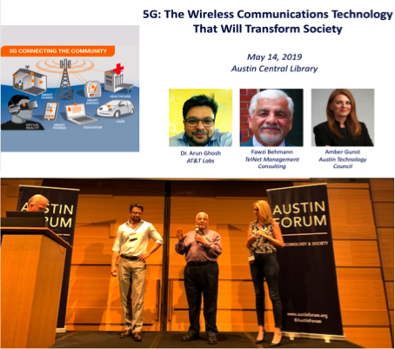
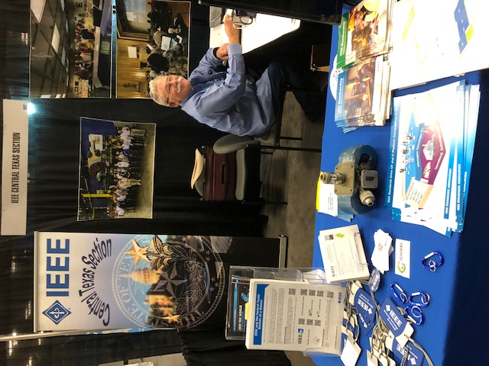
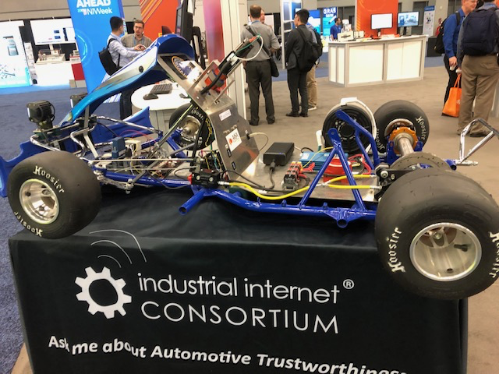
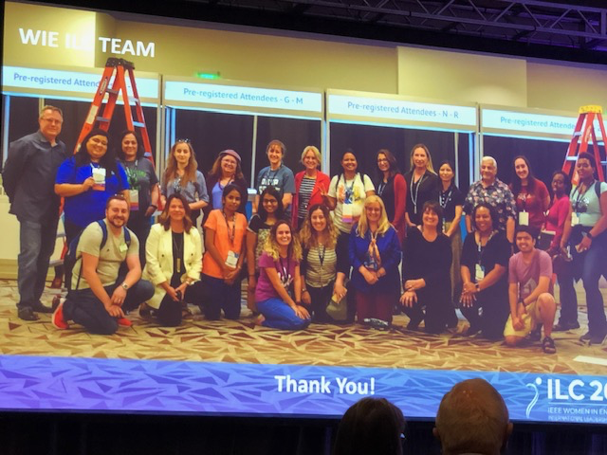
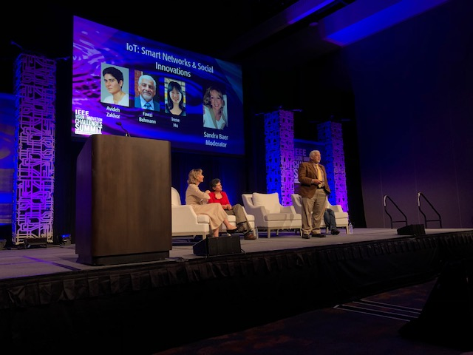

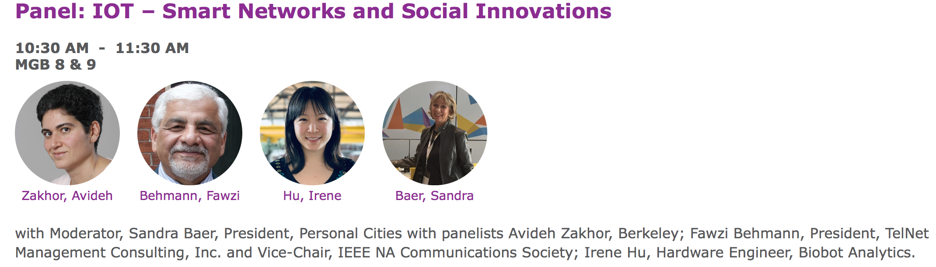
2019 Initiatives & Key Accomplishments
NI/WIE

Slide 16
2019 Initiatives & Key Accomplishments
Create awareness and base for future collaboration within IEEE and as well as with industry
Examples:
Submitted bid for Austin Globcom2022, currently working on a 2022 bid for WCNC
Exploring opportunity for outreach student project with UT Computer department
Encourage students to develop and deliver Student conference as a step for connection within CTS students community
We have invitation to connect with students in other sections in the region, within US and in some select countries.

Slide 17
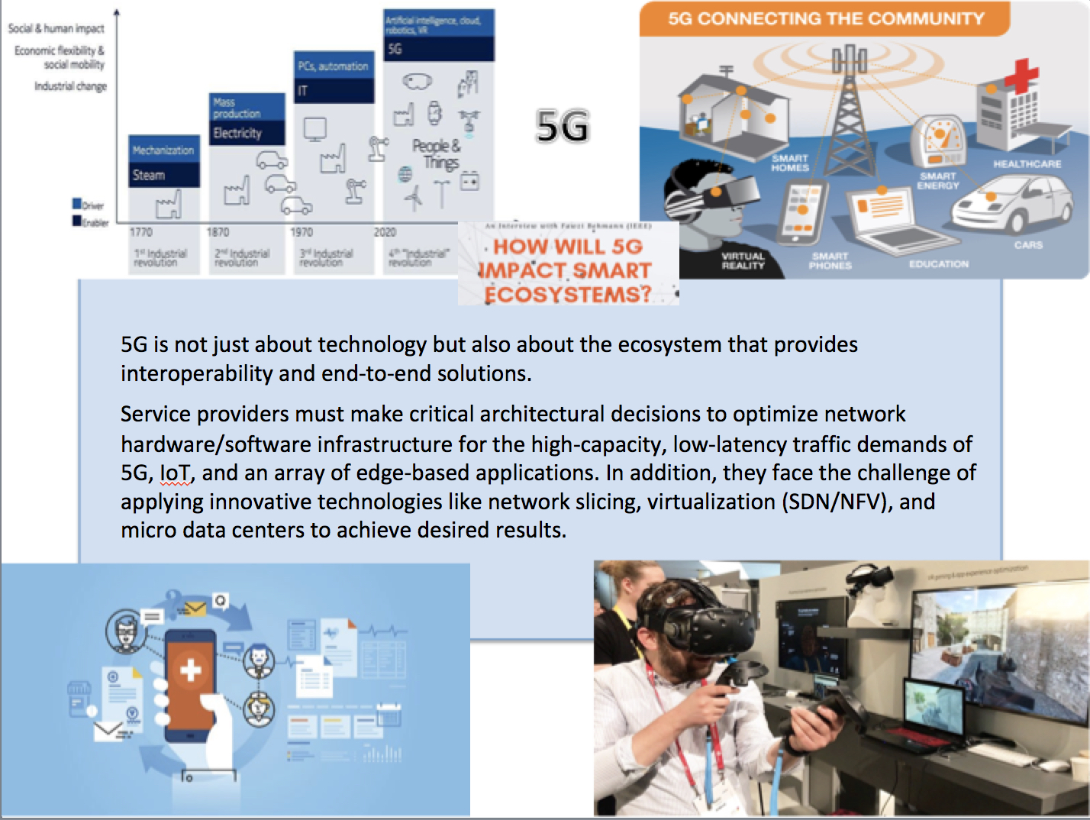
2019 Chapter Outreach & Collaboration

Slide 18
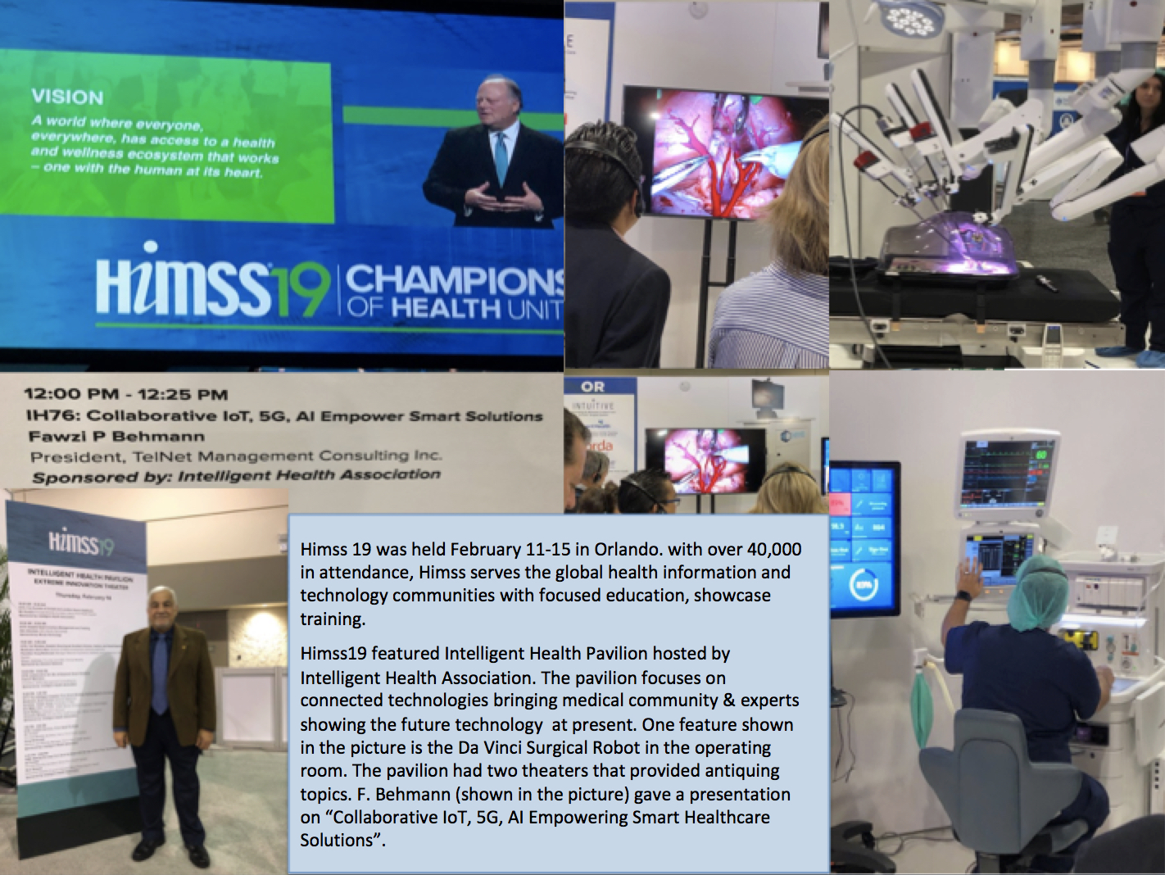
2019 Chapter Outreach & Collaboration

Slide 19
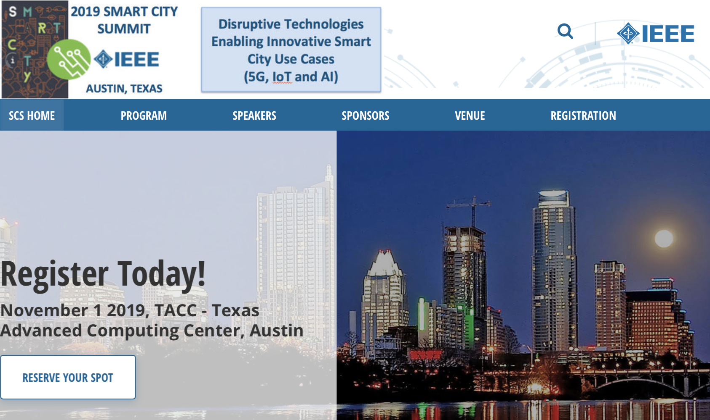
2019 Chapter Outreach & Collaboration

Slide 20
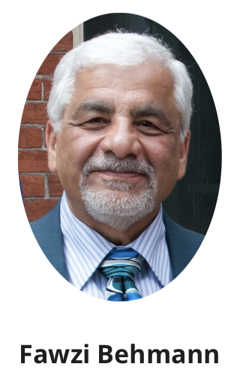
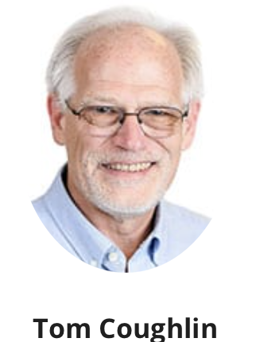
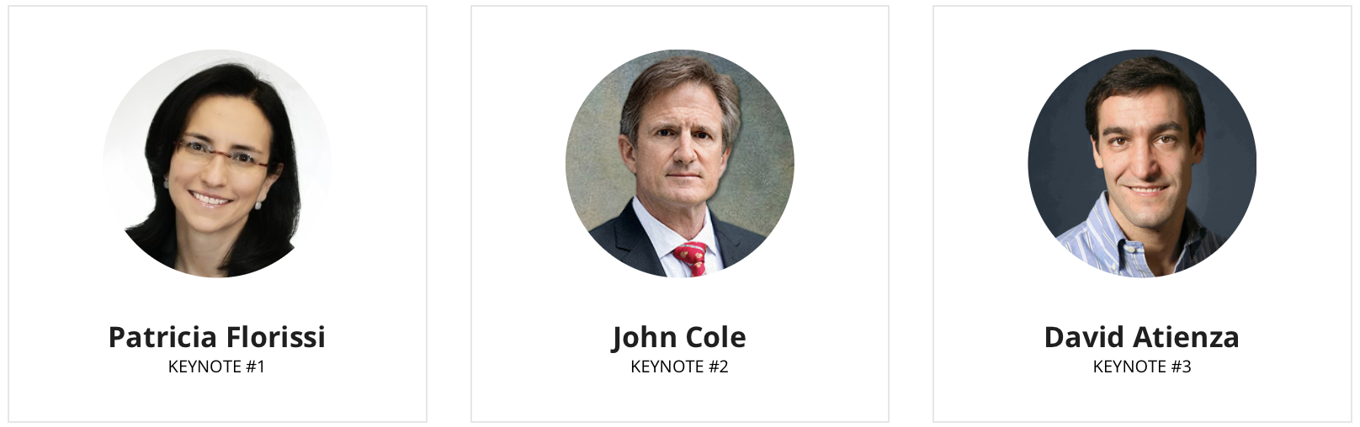
2019 Chapter – Society Outreach & Collaboration

Slide 21
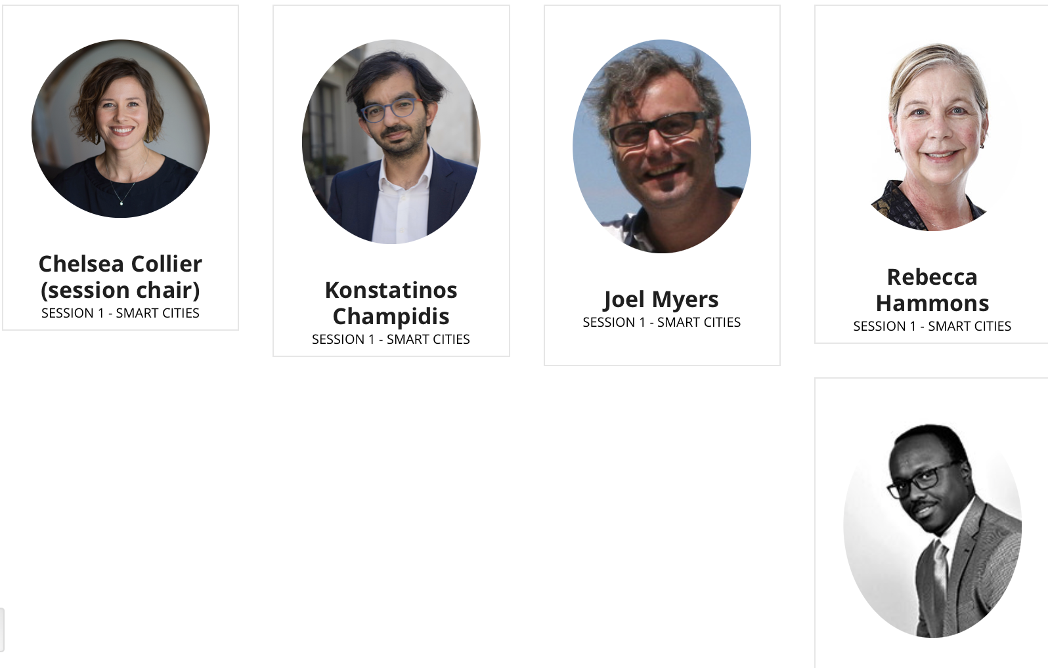
2019 Chapter – Society Outreach & Collaboration – Smart Cities

Slide 22
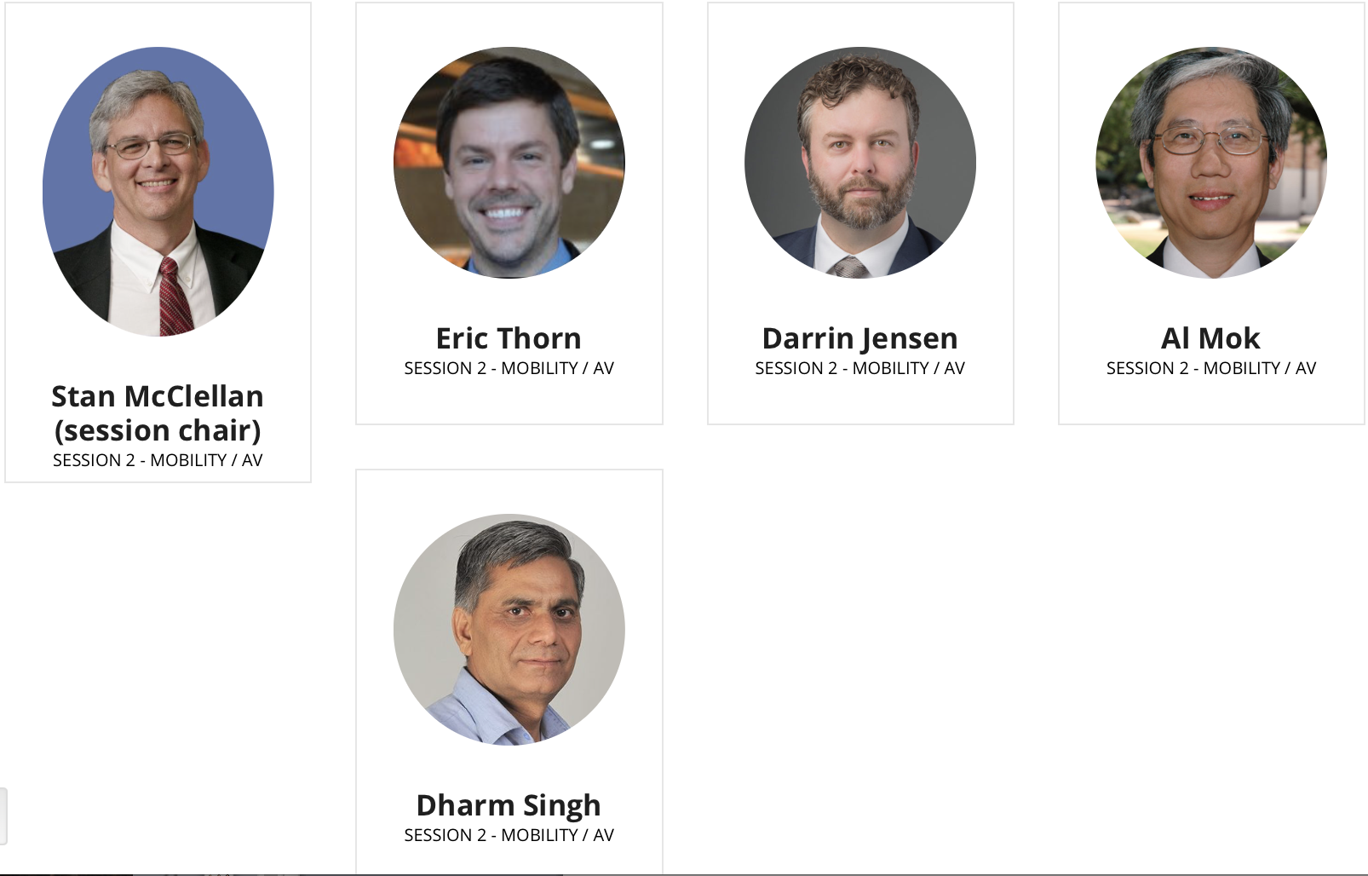
2019 Chapter – Society Outreach & Collaboration - Mobility

Slide 23
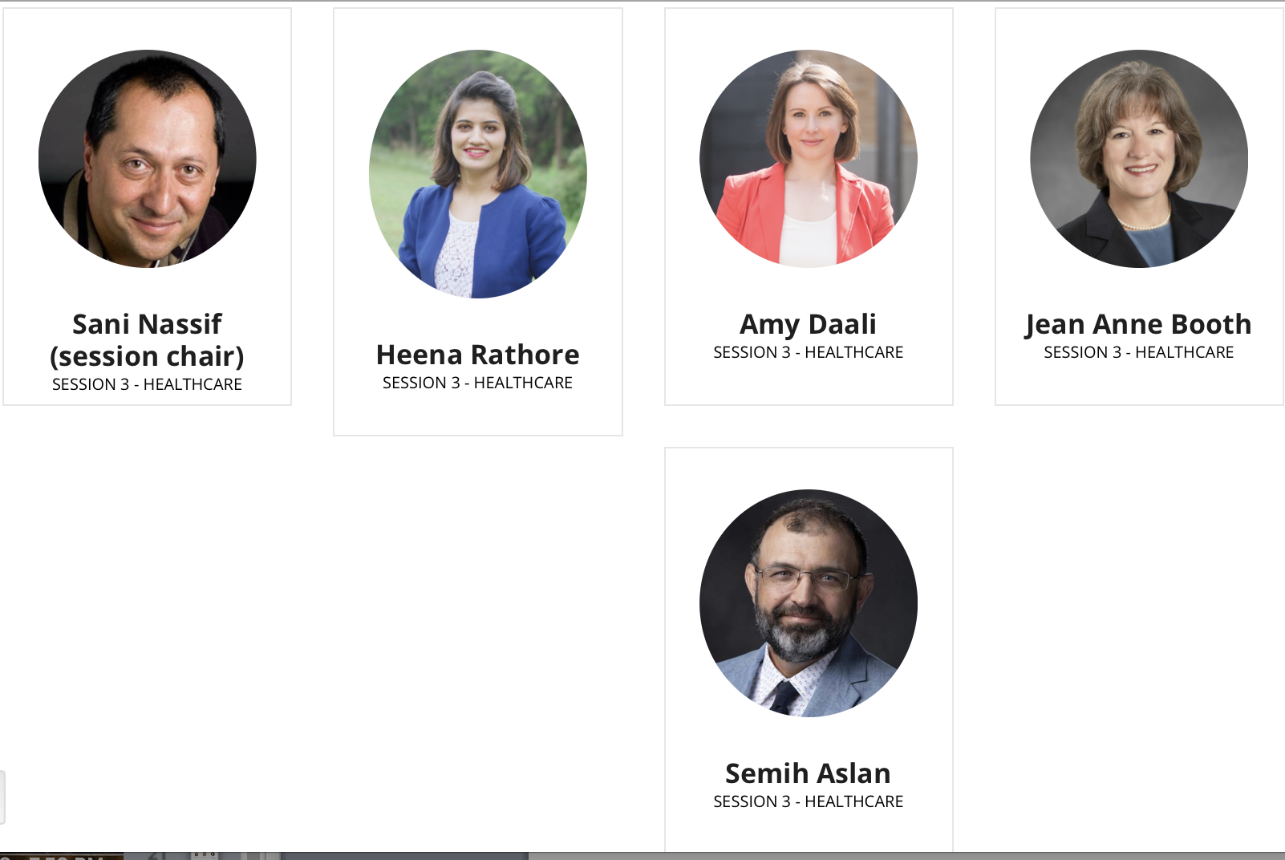
2019 Chapter – Society Outreach & Collaboration - Healthcare

Slide 24

2019 Chapter – Society Outreach & Collaboration

